Slide 1
Capstone Project
Chinese Cuisine in Toronto

Slide 2
Problem Statement
The city of Toronto is a very big city with a large variety of cuisines. Many visitors from Asia like to go to Toronto, but they may have problems finding food that they like. For this project, we will make use of data from FourSquare, and identify neighbourhoods that have great Chinese Cuisines. We will recommend the Chinese Restaurants based on their "Likes", "Ratings" and "Tips.

Slide 3
Data
Our primary sources of data on Toronto will be from the following:
1. Wikipedia: "https://en.wikipedia.org/wiki/List_of_postal_codes_of_Canada:_M"
2. Coordinates of Postal Codes: "http://cocl.us/Geospatial_data"

Slide 4
Approach and Analysis
1. Collect the Toronto City Data from Wikipedia
2. Using FourSquare API to find all venues for each neighborhood.
3. Filter out the Chinese Restaurants
4. Find rating , tips and like count using FourSquare API.
5. Sort the restuarants based on "Likes", "Rating", "Tips"
6. Visualize data using folium library(python)

Slide 5
Importing and Cleaning Data
Web scape data from https://en.wikipedia.org/wiki/List_of_postal_codes_of_Canada:_M
Clean the data
Remove rows where Borough is “Non assigned”
If “Neighborhood” has missing data, put equal to “Borough”
Retrieve coordinates info from http://cocl.us/Geospatial_data

Slide 6
Define Functions
geo_location(address)
To get the latitude and longitude information using geopy
get_venues(lat, lng)
To get venue details (‘ID’, ‘name’, ‘category’) based on geocodes from FourSquare
get_venue_details(venue_id)
To get details venue information (‘Likes’, ‘Tips’, ‘Rating’) using venue_id from FourSquare

Slide 7
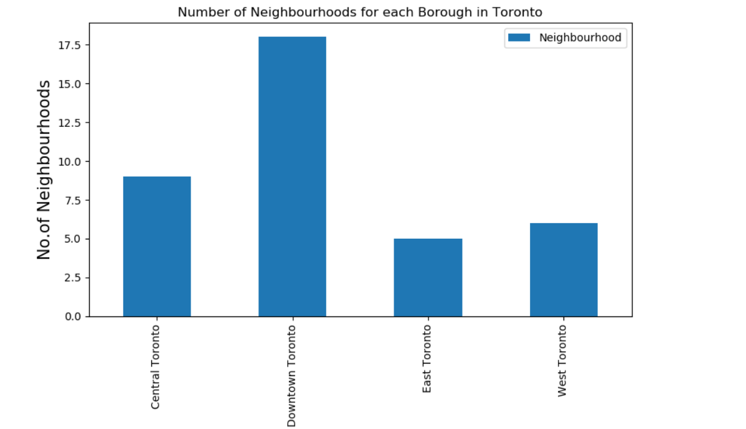
Results

Slide 8
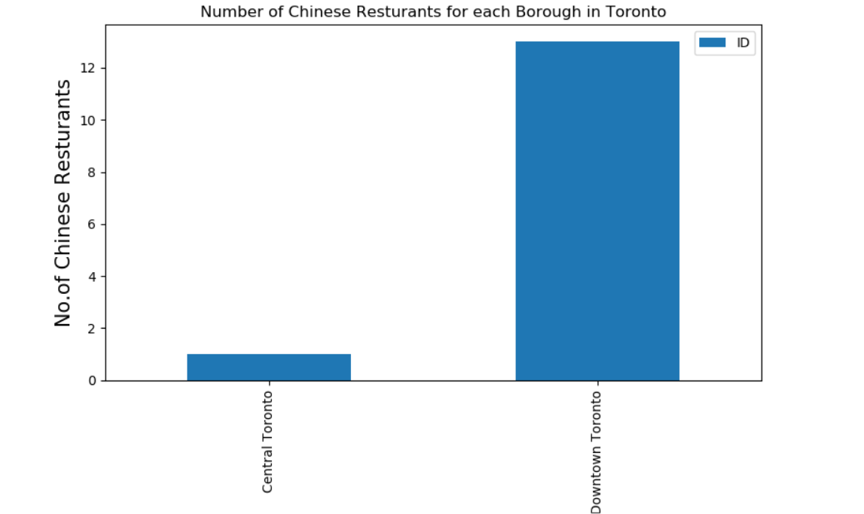
Results (cont’d)

Slide 9
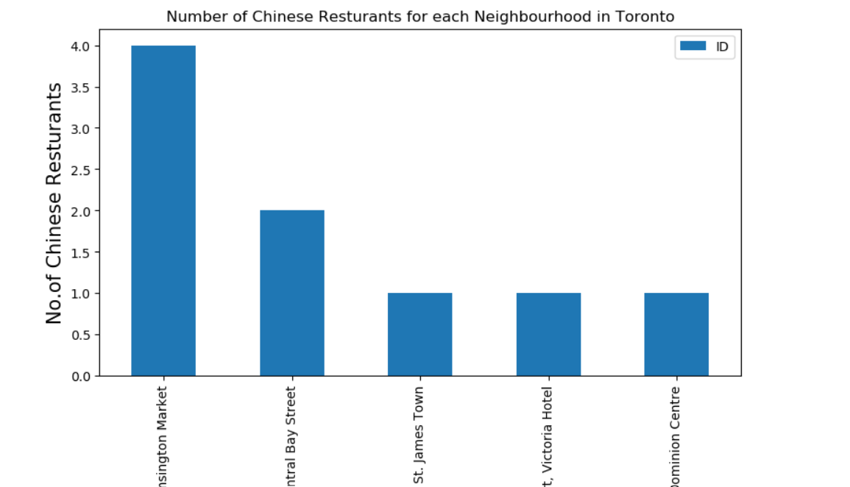
Results (cont’d)

Slide 10
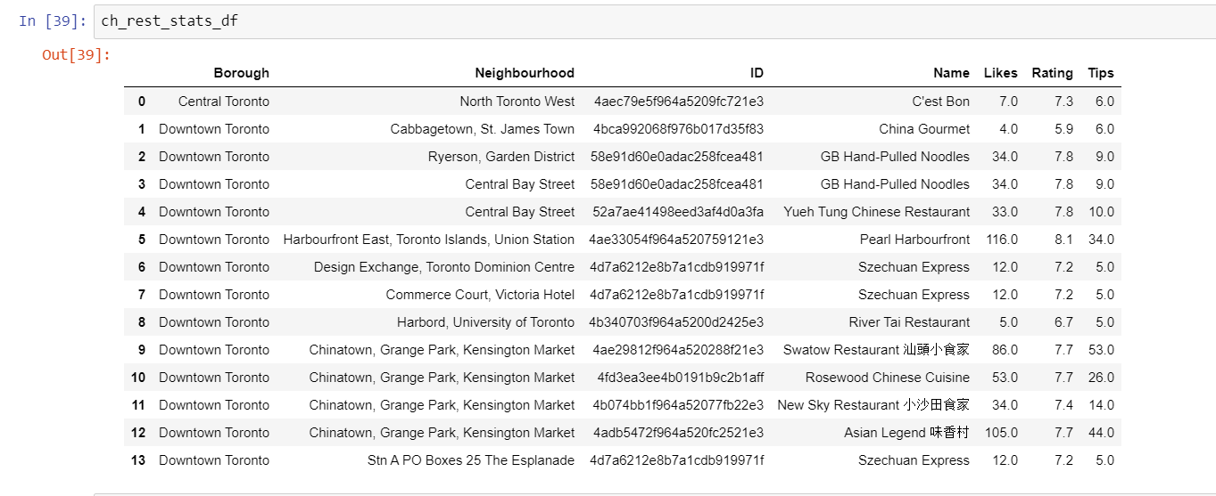
Analysis – Details of each restaurant

Slide 11
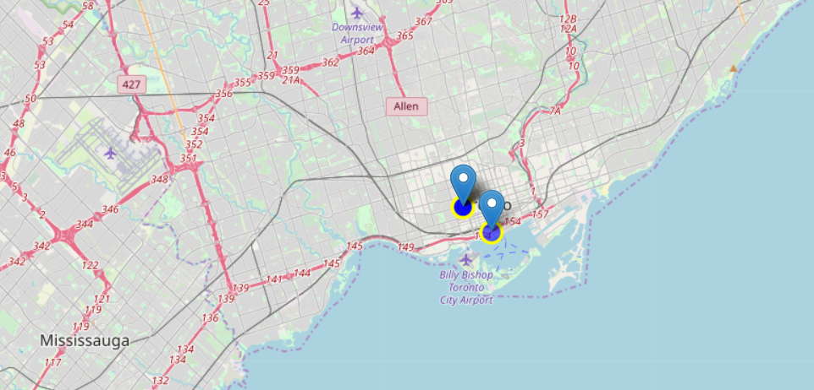
Analysis – Most Likes

Slide 12
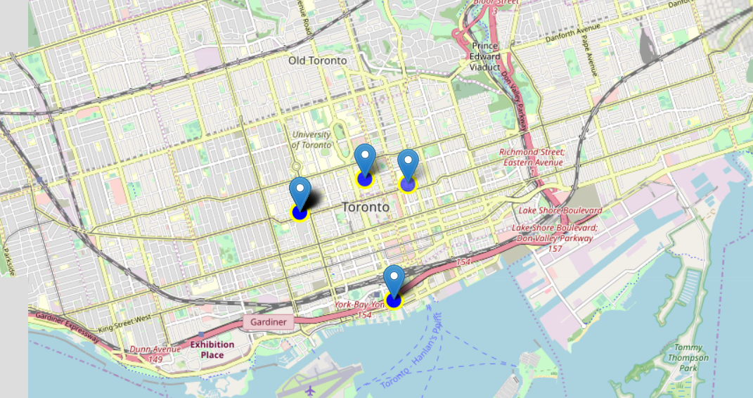
Analysis – Most Tips

Slide 13
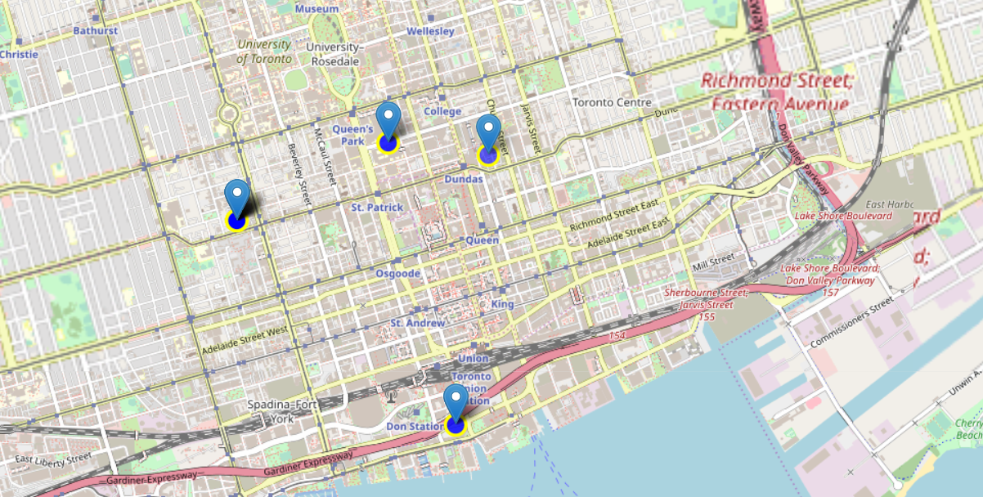
Analysis – Best Rating

Slide 14
Conclusions
Most of the Chinese Restaurants are located in Downtown Toronto
Specifically, Chinatown has the most numbers of Chinese Restaurants
Based on the data provided from Foursquares, we are able to pinpoint the exact locations of the restaurants that have the most "Likes", "Tips" or with the highest "Ratings"
We are then able to plot on a map, and for easy reference for any visitors to the city.
This project can be easily extended to other cities, or to identify other cuisines or landmarks.

